Slide 1
Infrared Sensor
MRE 320
Bryce Leeper

Slide 2
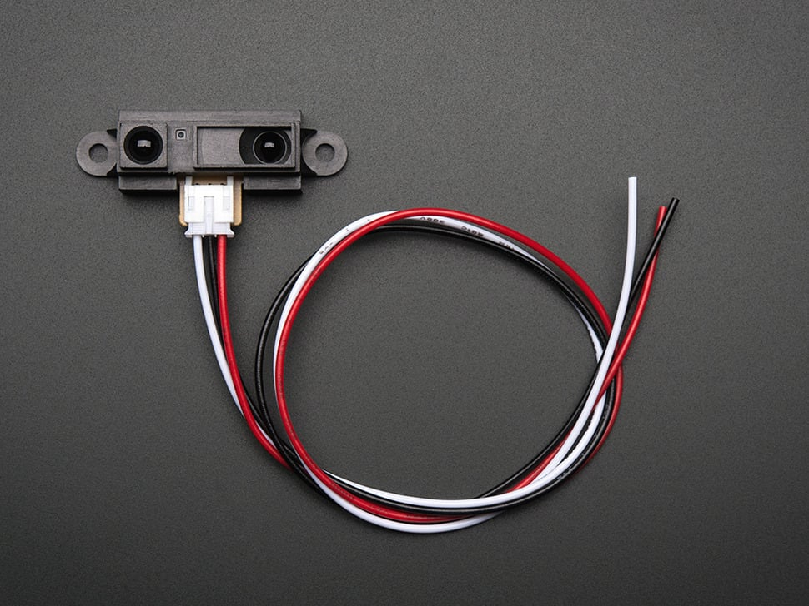
Basic Function
Emitter
Receiver
Voltage

Slide 3
Characteristics
Range: 4 to 32 inches
Analog
Supply voltage: 4.5V to 5.5V

Slide 4

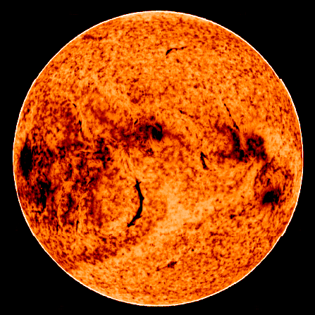
Interference
Light
Reflectiveness
Angle

Slide 5
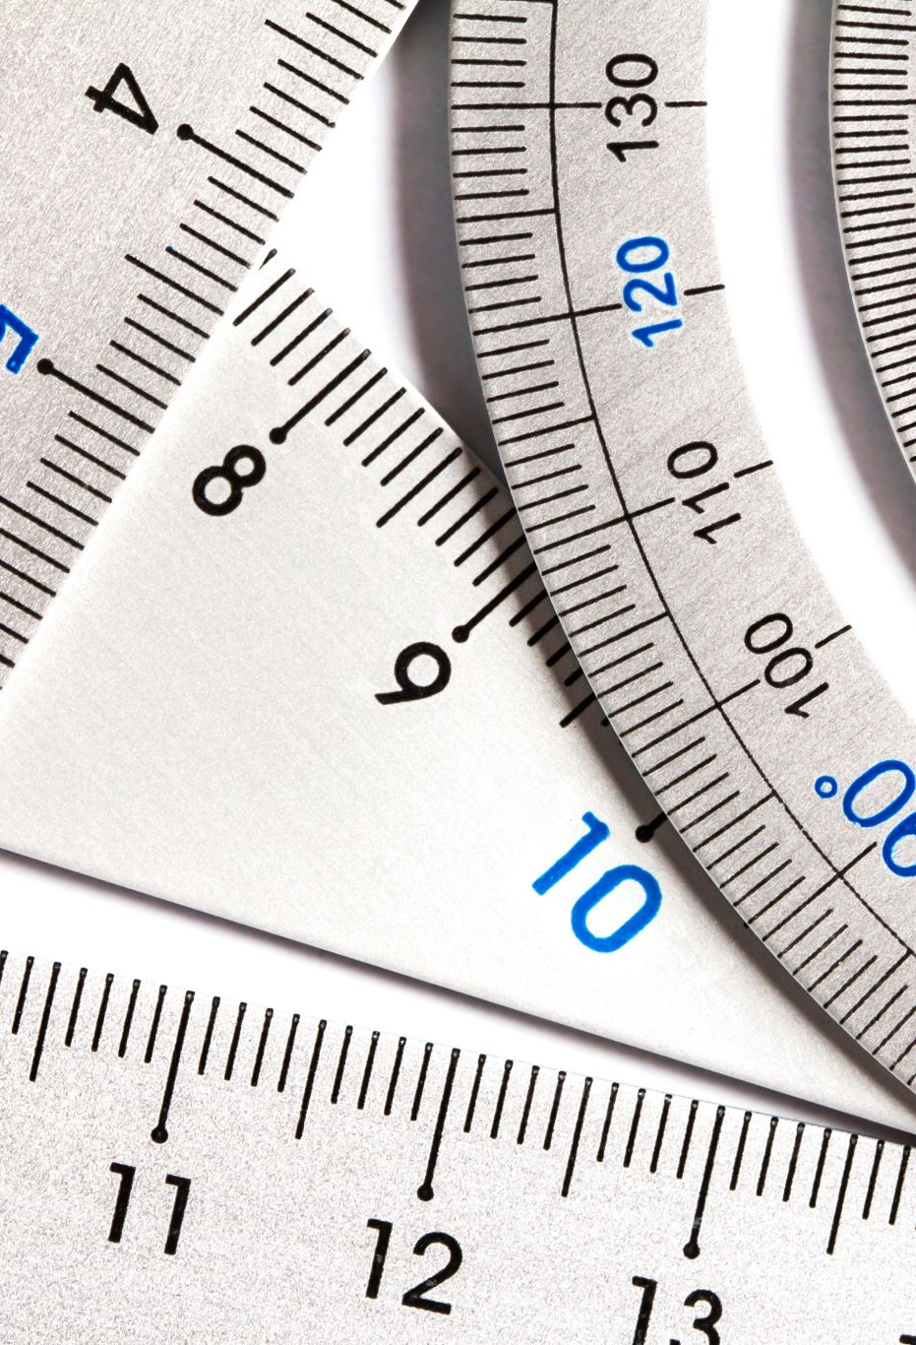
Test
Hand
Paper
  Ruler
  T-Square
  Level

Slide 6
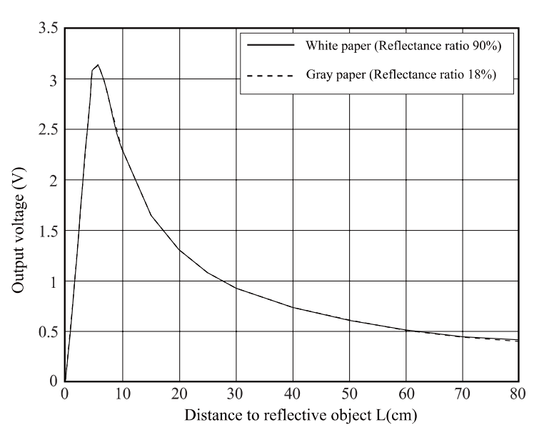
Data
Range
Resolution
Sensitivity
Repeatability
Accuracy
Precision

Slide 7
Applications
Touch-less switch
Sensor for energy saving
Amusement equipment

